Slide 1
Descriptive Statistics

Slide 2
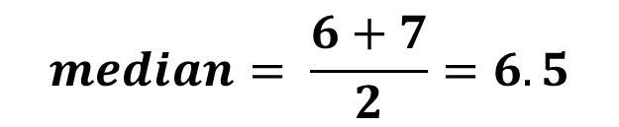

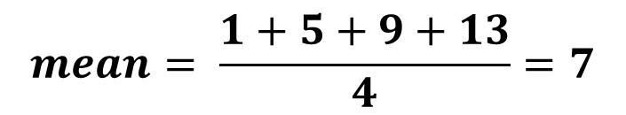

Measure of centrality
Median
Mode
Mean
[1,3,4,6,8]
$$median=4$$
$$median= \frac{6+7}{2}=6.5$$
[2,4,6,7,8,10]
[1,2,2,3,3,3,3,4,5]
$$mode=3$$
$$mean= \frac{1+5+9+13}{4}=7$$
[1,5,9,13]

Slide 3
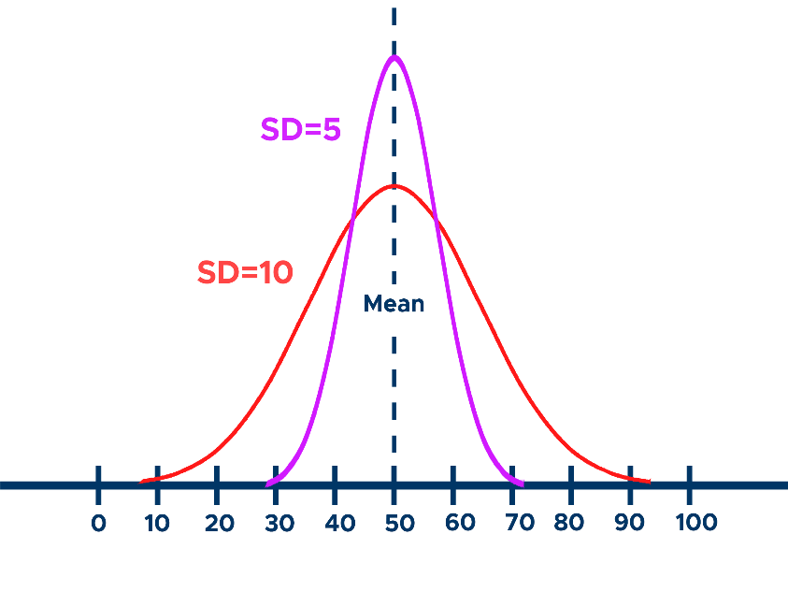


Variance and Standard deviation
Variance :
→ $σ^{2}=\frac{\sum_{i=1}^{N}{{(X_{i}−μ)}^{2}}}{N}$
→ $s^{2}=\frac{\sum_{i=1}^{n}{{(X_{i}−\overline{X})}^{2}}}{n−1}$
Standard deviation
$= \sqrt{Variance}$ = $σ=s$

Slide 4
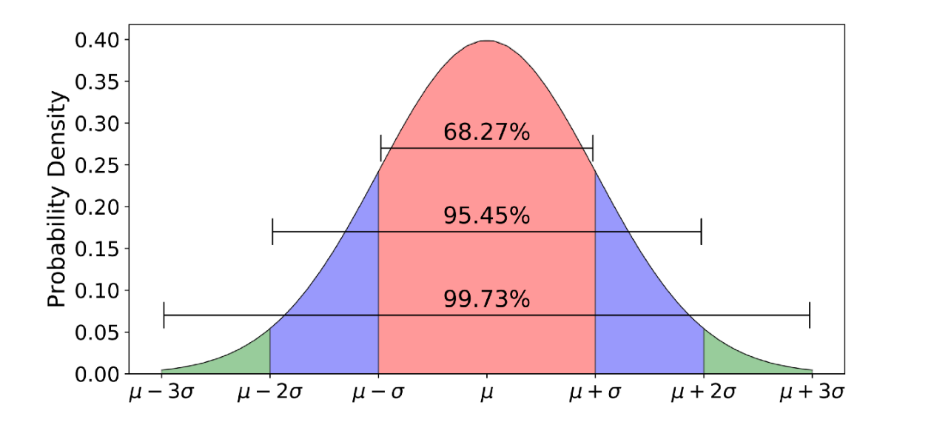



Normal distribution

Slide 5
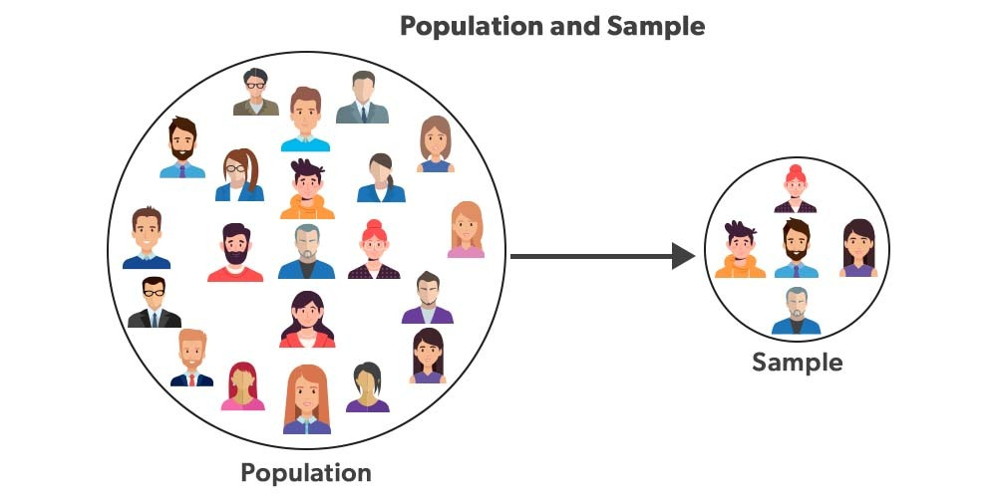




Population and Sample

Slide 6
Sampling
Samples are drawn randomly
The concept of sample variation
Sample representativity and generalizability
Point estimate

Slide 7
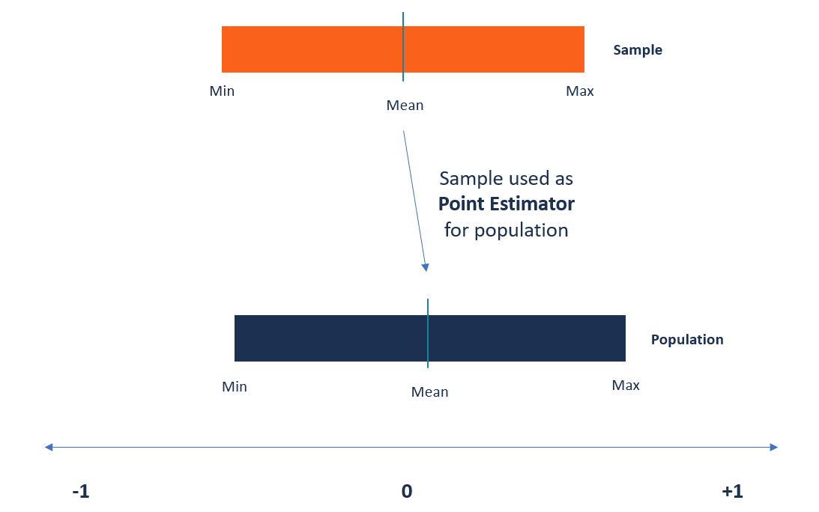
Point Estimation

Slide 8
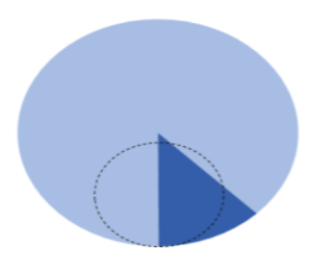
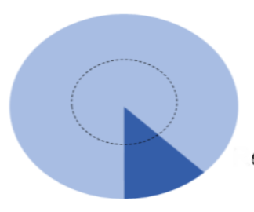

Sampling
Biased
Non-biased

Slide 9
Paradigm of sampling
Random
Non-biased and representative
Generalized to the population
The point estimate is good guess

Slide 10
Good guess (point estimate)
Accurate estimate
Precise estimate

Slide 11
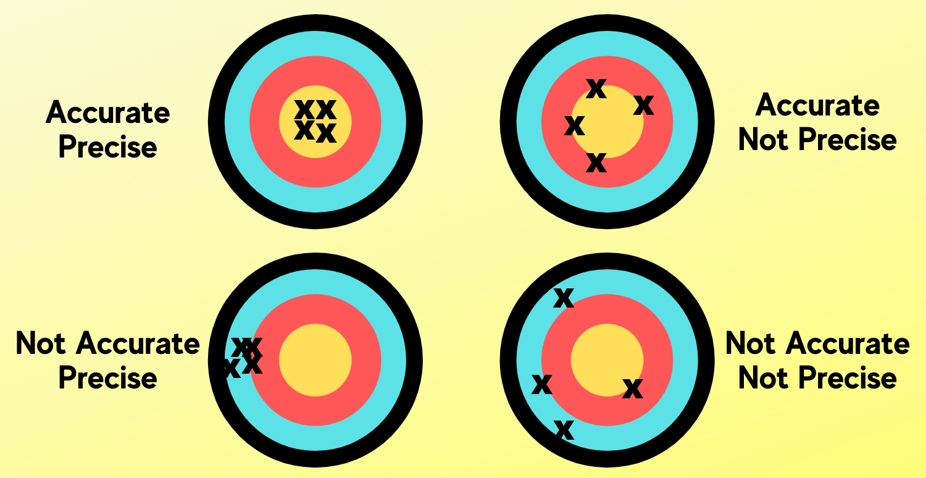
Accuracy and precision
So it’s better to take one large sample rather than many small samples

Slide 12
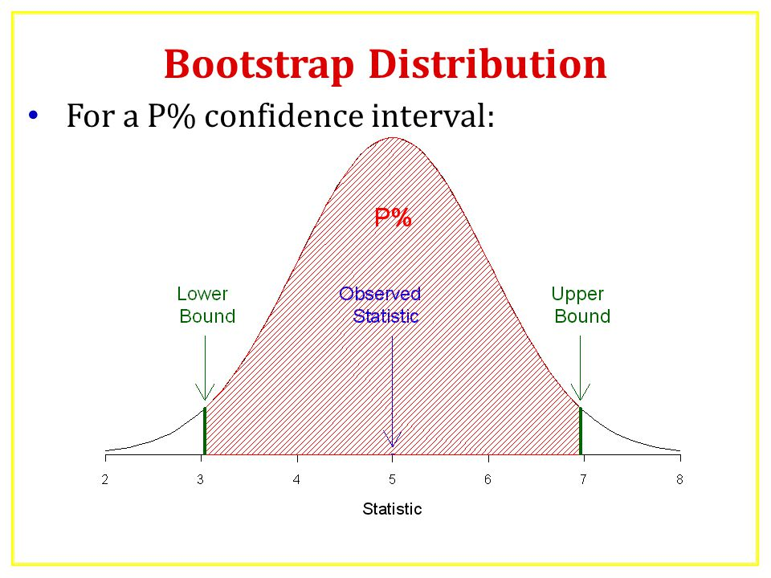
Bootstrapping
Resampling with replacement

Slide 13
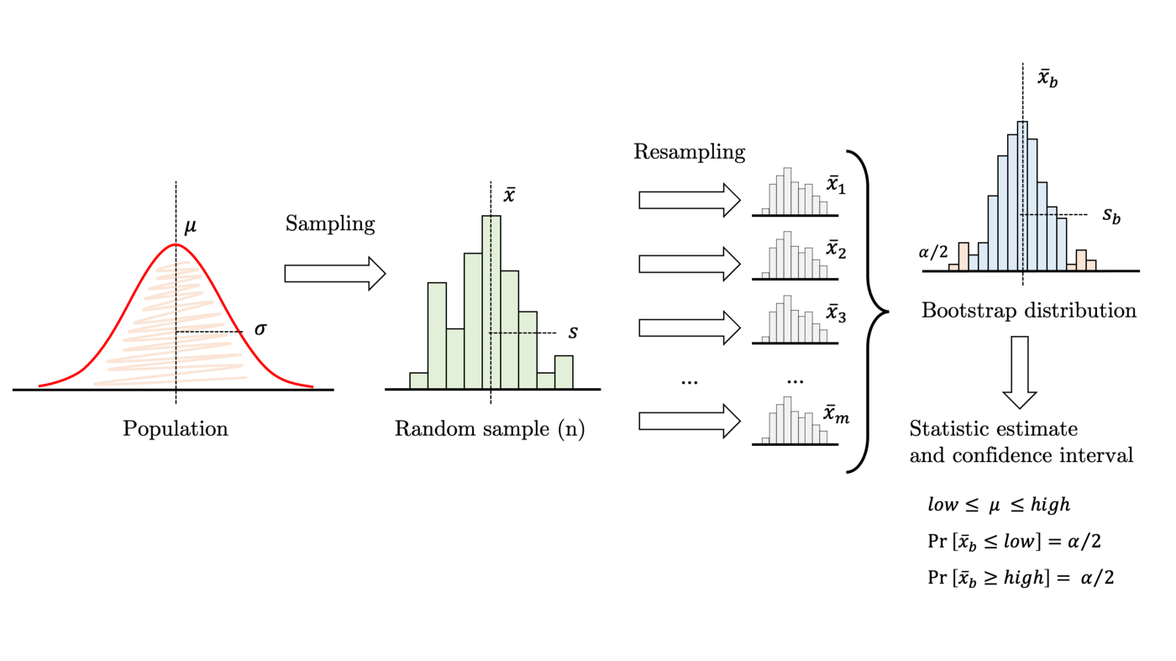


Slide 14
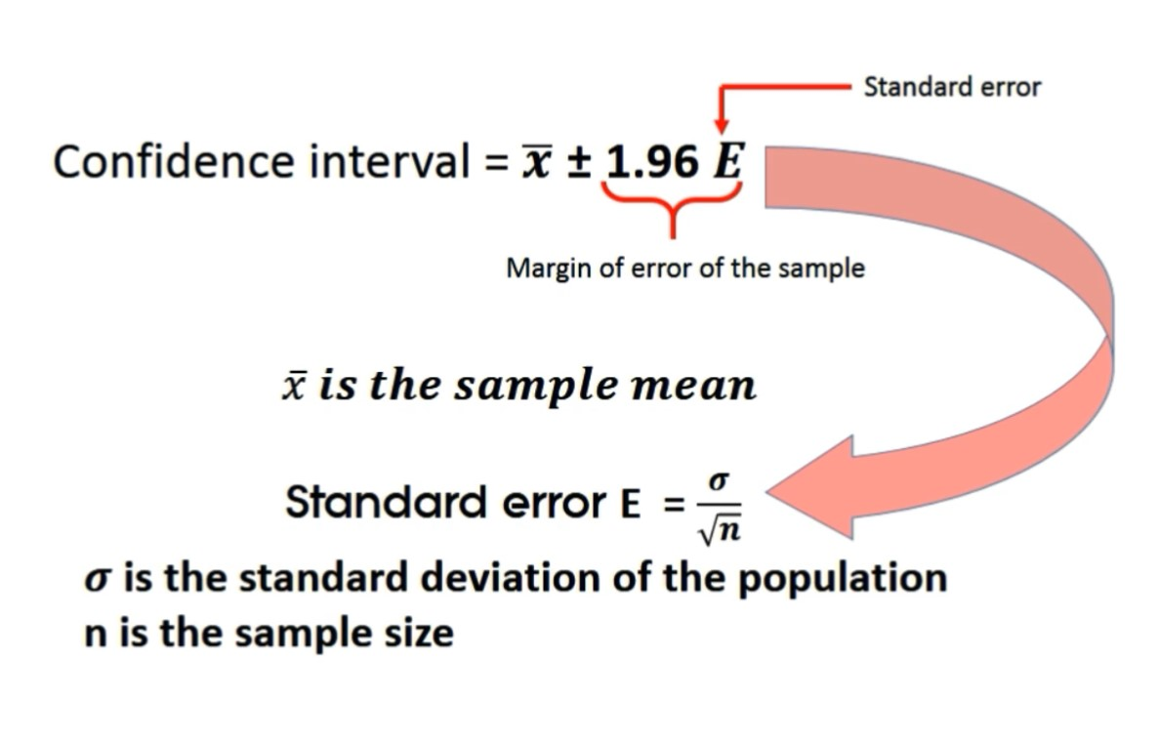
Percentile method

Slide 15
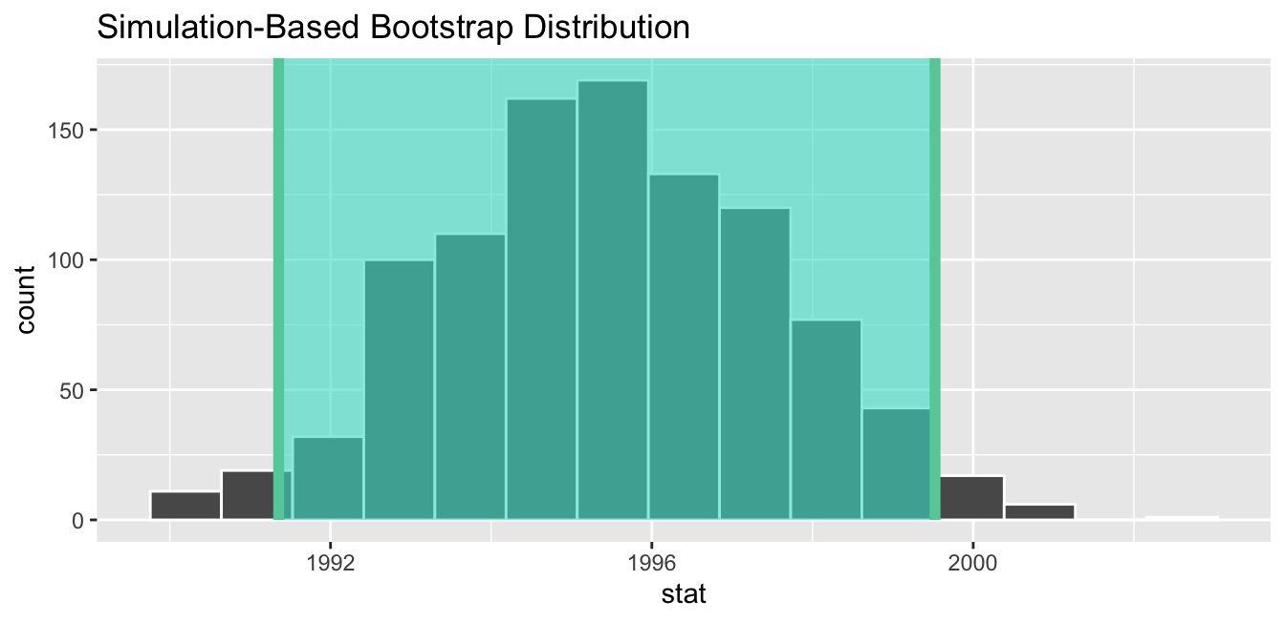

Slide 16
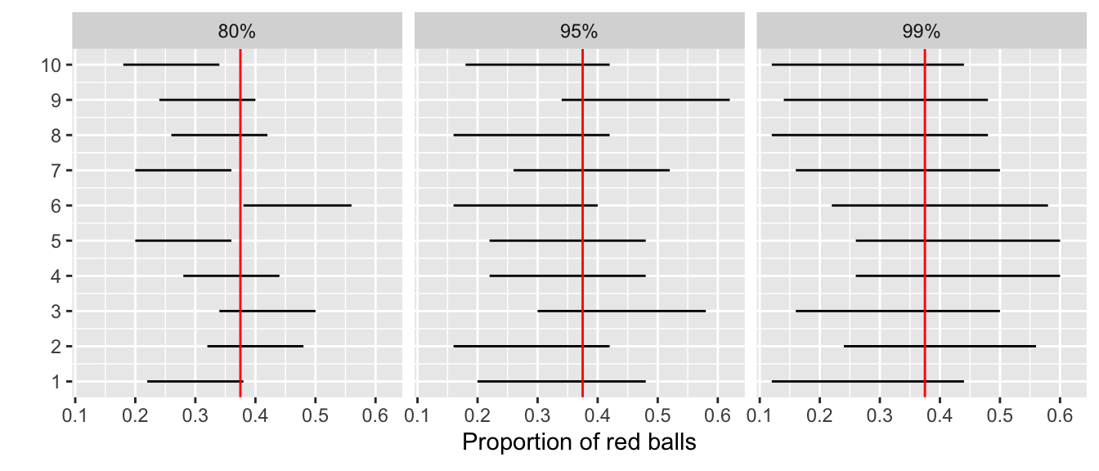
Impact of confidence level

Slide 17
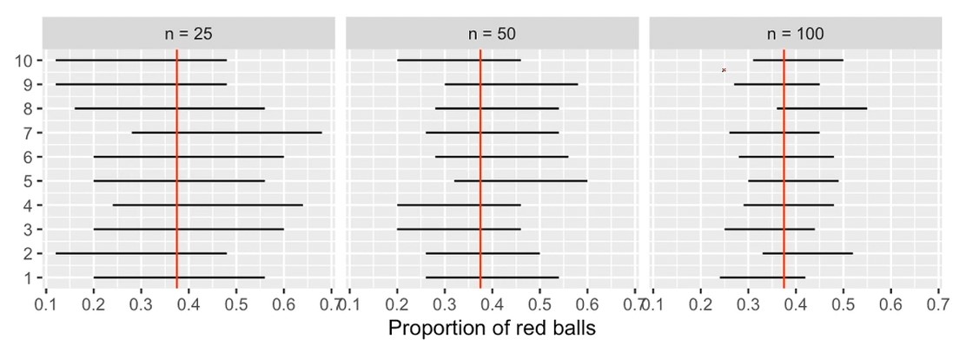
Impact of sample size

Slide 18
Hypothesis tests
Null hypothesis
Alternative hypothesis
denoted by h0
sample observations result purely from chance
Denoted by h1 or ha
Sample observations are influenced by non-random cause

Slide 19
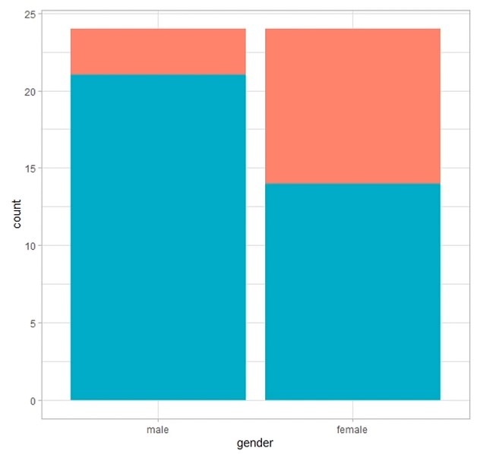
Test case to understand terminology
21 males were selected from 24 so the proportion is 87.5%
14 females were selected from 24 with a proportion of 58.3%
With these proportions it seems that males are 87.5 – 58.3 = 29.2% higher than women

Slide 20
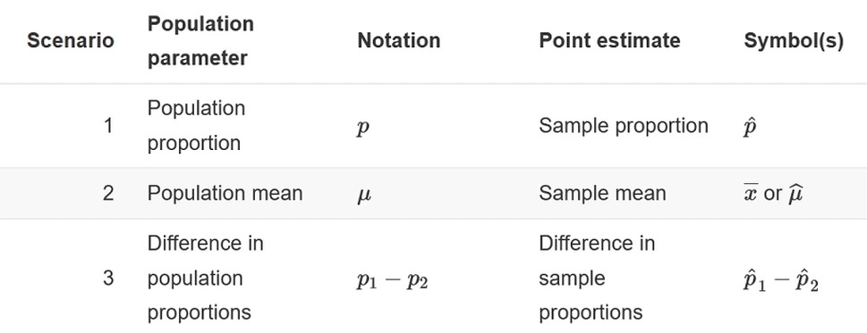
Test statistics

Slide 21
Statistical significance (α)
Statistical significance helps quantify whether a result is likely due to chance or to some factor of interest

Slide 22
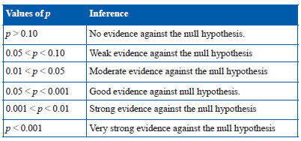
P-value

Slide 23
Types of hypothesis tests
Chi square
T-test
ANOVA

Slide 24
T-Test
Compare the average of two datasets and determine if they came from the same population or not

Slide 25
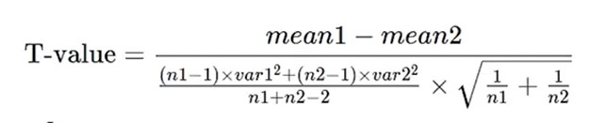
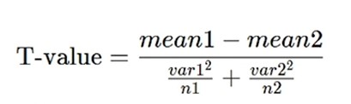
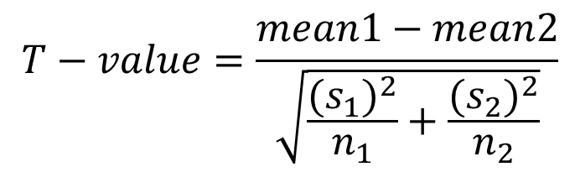
Types of T-test
Correlated (paired) T-test
Equal variance (pooled) T-test
Unequal T-test
$$T−value=\frac{mean1−mean2}{\sqrt{\frac{{(s_{1})}^{2}}{n_{1}}+\frac{{(s_{2})}^{2}}{n_{2}}}}$$

Slide 26
Analysis of variance (ANOVA)
One-way ANOVA: 1 independent variable
Two-way ANOVA: 2 independent variables
N-way ANOVA: N independent variables

Slide 27
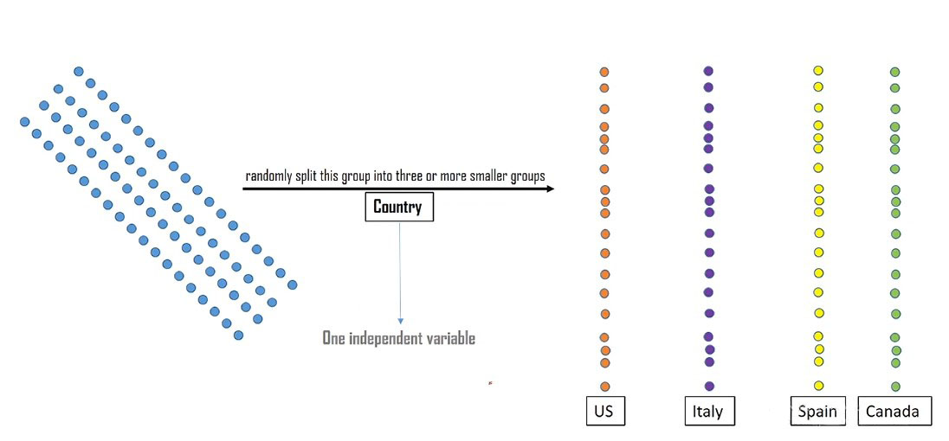
Example of 1-way ANOVA

Slide 28
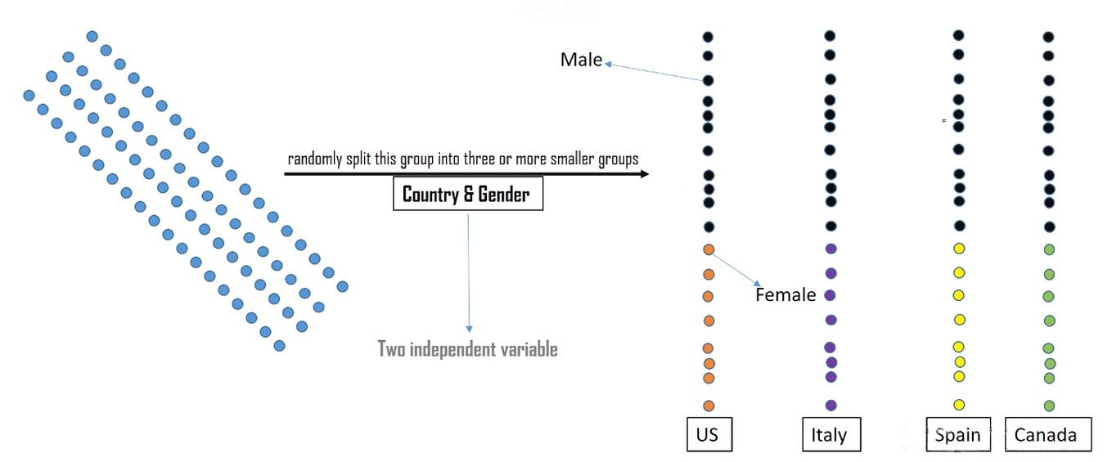
Example of 2-way ANOVA

Slide 29
Chi square test
It test the relationships between categorical variables not numerical
Where the null hypothesis mean that there is no relationship

Slide 30
Types of error
Type 1
Type 2
It refers to rejecting the null hypothesis when you shouldn’t reject it
False positive
It can be avoided by reviewing α
It refers to not rejecting the null hypothesis when you should.
False negative
It can be solved by increasing the sample size

Slide 31


Any questions ?

